Slide 1
10861NAT Diploma of Aboriginal and Torres Strait Islander Legal Advocacy
LEGAL RESEARCH

Slide 2



Acknowledgement of Country
We acknowledge the traditional owners of the land on which Tranby stands, the Gadigal people of the Eora nation. We pay our respects to their Elders both past and present, who remain the traditional knowledge holders of this land.
We proudly extend this respect to all current and emerging leaders around Australia, for they hold the memories, the traditions, the culture and the future of their people.

Slide 3
LEGAL RESEARCH
Why are legal research skills important?
The law is constantly changing
Knowing where to find new developments is one of the most useful skills for graduates
Practitioners need these vital skills from their paralegals
Increase in the amount and complexity of online information

Slide 4
LEGAL RESEARCH
Strategic Approach to Legal research
Identify and analyse the salient facts
Determine the legal issues involved and formulate the research accordingly e.g. are you being asked to find a precedent, a section from legislation, change in the law, ALRC report, etc.
Research the issues thoroughly using primary and secondary sources
Evaluate the results

Slide 5
LEGAL RESEARCH
Two types of legal research resources
Primary Sources
Legislation
Case Law
Parliamentary committee reports (House and Senate)
Hansard (verbatim reports of Parliamentary proceedings)

Slide 6
LEGAL RESEARCH
2. Secondary Sources (include)
Journals (peer reviewed)
Textbooks
Case notes
Legal encyclopedias
Digests
Other sources of law that provide commentary

Slide 7
LEGAL RESEARCH
Trusted Information
Authority – ensure the material is coming from a reputable source
Objectivity – no bias
Accuracy – is it well-researched? Does it have references?
Relevancy – is it relevant to your task?
Currency – this is critical in the field of law where laws often change
Be wary of online resources like: Go to court, Shine Lawyers, etc. can be a good place to start but do not rely on the information in them. Aimed at a lay person audience.

Slide 8
LEGAL RESEARCH
Open Resources/Australian Law Reform Commission Reports
https://www.alrc.gov.au/publications/
https://www.alrc.gov.au/publication/recognition-of-aboriginal-customary-laws-alrc-report-31/
(ALRC Report on recognition of Aboriginal Customary Law)

Slide 9
LEGAL RESEARCH
Open Resources/Legal Dictionaries
https://thelawdictionary.org/
https://www.oxfordreference.com/

Slide 10
LEGAL RESEARCH
Open Resources/General Legal Information
http://www.austlii.edu.au/
AustLII publishes public legal information -- that is, primary legal materials (legislation, treaties and decisions of courts and tribunals); and secondary legal materials created by public bodies for purposes of public access (law reform and royal commission reports for example) and a substantial collection of law journals

Slide 11
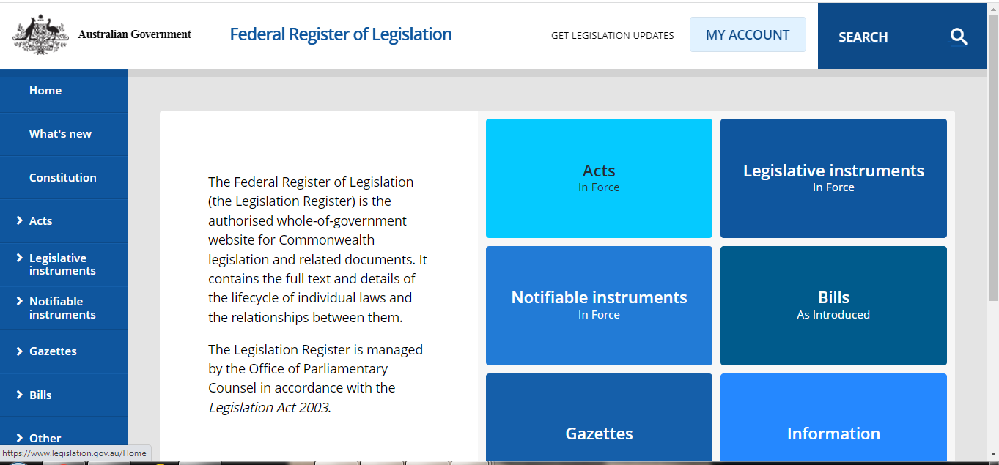
LEGAL RESEARCH
Open Resources/Federal Legislation
www.legislation.gov.au

Slide 12
LEGAL RESEARCH
OpenResources/State Legislation
https://legislation.nsw.gov.au/
https://www.legislation.vic.gov.au/
https://www.legislation.tas.gov.au/
https://www.legislation.sa.gov.au/legislation
https://www.legislation.wa.gov.au/
https://www.legislation.qld.gov.au/
https://legislation.nt.gov.au/
https://www.legislation.act.gov.au/

Slide 13
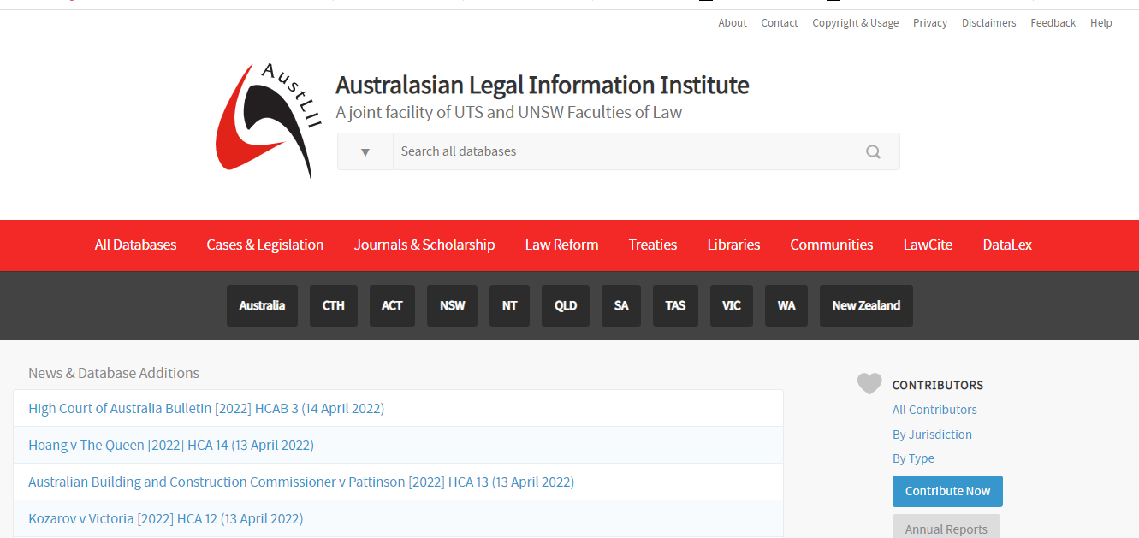
LEGAL RESEARCH
Open Resources/Federal and State Legislation
http://www.austlii.edu.au/

Slide 14
LEGAL RESEARCH
Open Resources/Case Law
http://www.austlii.edu.au/
Austlii contains case law and unreported judgments for all Australian Commonwealth, States and Territories. Coverage includes High Court of Australia, Family Court of Australia, Supreme Court of NSW and the District Court of NSW and more.
NOTE: Cases in Austlii are not the official authorised version!

Slide 15
LEGAL RESEARCH
Open Resources/Case Law
Jade: https://jade.io/t/home
JADE (Judgments And Decisions Enhanced) is a free caselaw and legislation database. JADE can be used to search for or browse Australian legislation and court and tribunal decisions, and receive alerts of new decisions and court digests. A basic JADE account is free for anyone once you register.

Slide 16
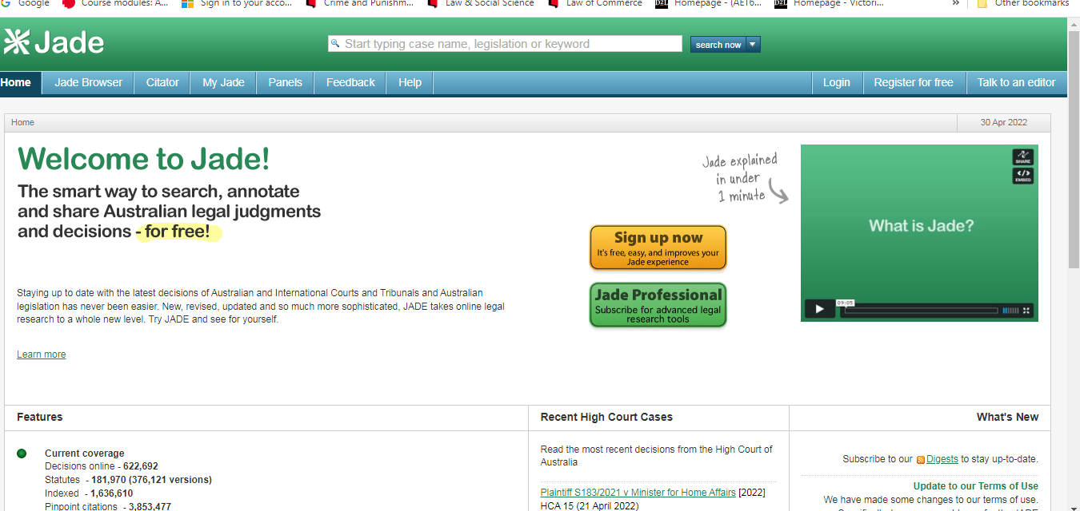
LEGAL RESEARCH
Jade: https://jade.io/t/home

Slide 17
LEGAL RESEARCH
What are authorised law reports?
Authorised reports contain judgments that have been reviewed by the Judges or Judge's Associate, prior to the publication. They are therefore considered to be accurate record of the judgment.
What is an unauthorised report series?
Unauthorised reports are a legitimate record of court decisions. In some cases, the unauthorised report may be the only source to locate certain cases, particularly matters from local courts and tribunals covering specialised areas of law.

Slide 18
LEGAL RESEARCH
What is an unreported case?
Unreported judgments are decisions of courts that have not been published in a law report. The decision may not have been published because for a number of reasons, such as the case being too recent, the case does not add any additional authority to the body of case law or it may have been overlooked as it is considered of little significance at the time.
Why use authorised reports?
In Australia, if a decision appears in an authorised report series, this is the version that must be cited in student essays and scholarly publications - see Rule 2.2.2 in AGLC4.
In all Australian courts, there is a convention that the authorised report of a judgment be cited and handed up in court in preference to other versions.

Slide 19
LEGAL RESEARCH
Effective Legal research for the Modern Lawyer
https://www.youtube.com/watch?v=Nmoy2PQo0z8

Slide 20
LEGAL RESEARCH
AGLC4 Referencing Guide
https://law.unimelb.edu.au/mulr/aglc/about

Slide 21
LEGAL RESEARCH
Indigenous Law Resources
http://www.austlii.edu.au/au/other/IndigLRes/
This collection includes parliamentary papers, government reports and policy documents affecting Indigenous Peoples, reports and submissions by civil society organisations, documents related to significant test cases and legal proceedings and Indigenous advocacy.
https://www.indigenousjustice.gov.au/
Indigenous Justice Clearing House a national resource on Indigenous justice

Slide 22
LEGAL RESEARCH
Thank you!

